Slide 1

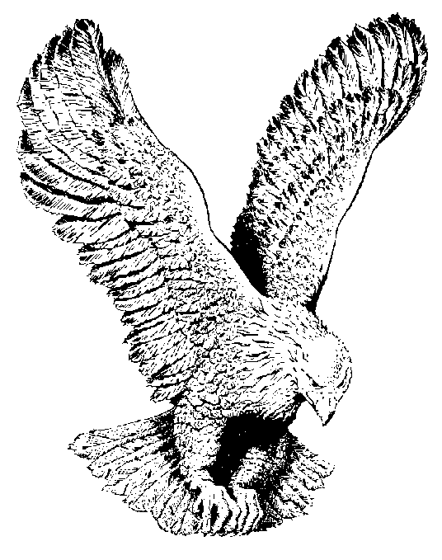
GLAD DAY
Glad day when I was born again
Glad day when I was born again.
Glad day when I was born again.
It was a glad day when I was born again.
The sins I used to do, I do them no more,
The sins I used to do, I do them no more,
The sins I used to do, I do them no more,
It was a glad day when I was born again.

